Slide 1
Buizy The paperless Rolodex
By: Jonathan, Krissy, Tom, and Luan

Slide 2
This app’s purpose is to satisfy the demand of busy business people to organize their business contacts all in one place.
After visiting a trade fair, what would business executives do when they collected hundreds of business cards?
(Probably cry)
What is Buizy?

Slide 3
Our app provides the convenience for users to capture an image of the business card on their smartphones and has the ability to read the content from the card and save the data into their contacts.
What is Buizy? (Cont.)
After generating a contact, the contents of each person’s profile can also shared in a stand alone social media platform.
This platform would also have the ability to connect with other well established platforms.

Slide 4
Basic Information
Scope and Scale
Per the feedback from the draft 1 presentations and mockups, our scope has been refined to any person that possesses and uses a smartphone (over 77% of the US according to PEW Research). Everyone needs a way to sort their contacts! In terms of scale, we hope to reach 10% of the world’s population by 2020.
Examples of Users and Their Tasks
College students
Recruiters
Business professionals
Private sector
Anyone looking to save time while networking!
Relationship with Present Technologies
The three largest app platforms currently are iOs, windows, and android on mobile devices. Compatibility to sync with the contact lists in these three platforms is critical.

Slide 5
329,123,000
253,424,710 users
77%
(Census.gov. 2018) That’s a lot of people in the U.S.
And a lot of smartphone owners
(PEW Research, 2017)

Slide 6
Our process is easy!
The man in the grey sweater below is Steve Krug… he was our legislator. He made the laws around here…
Our app does the thinking for you. You just close the deal.
Download the app
Make an account
Start scanning
Available on iOs, android, and Windows!
You have a first name? You have an account!
Start networking in the future!
1
2
3

Slide 7
2. Screen Mockups
Let’s have a quick glance at what the app would look like.

Slide 8
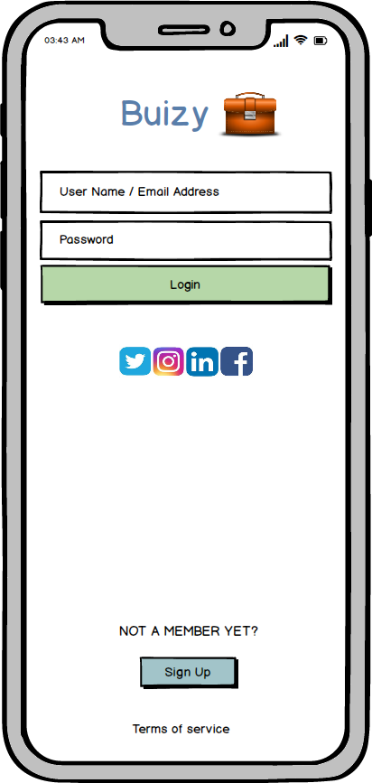
Login Page
Place your screenshot here
This is the initial page when the user logins to the app either by entering the user name or the email associated with the account to login. The social media icons allow users to go into Buizy’s social media pages. For non-members, there is an option to sign up to the privileges of using our app. Terms of service link is available to allow users to view our Terms of Service.

Slide 9
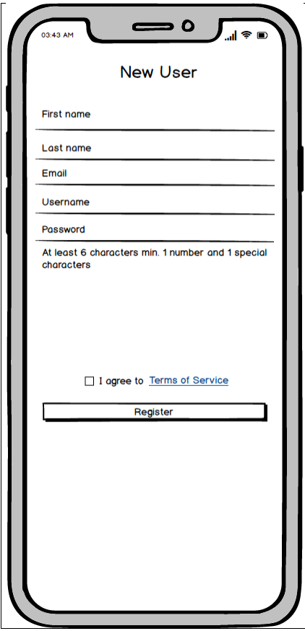
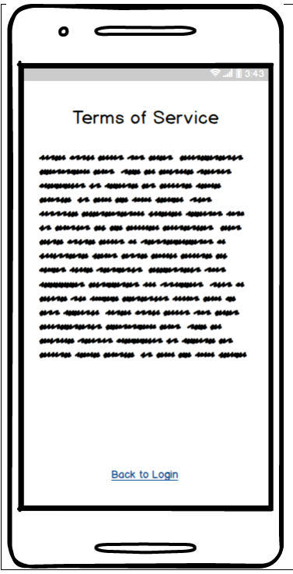
New User and TOS
Place your screenshot here
This is the page for new user to enter all the information for the app to get started. To enhance security, users are required to follow certain format for password to be allowed in the system. Our app will verify against our database whether a username has already been chosen. If so, a message will be displayed under the “Username” field to prompt the user to enter a different username. Users are required to check to box next to Terms of Service link to proceed for the registration.

Slide 10
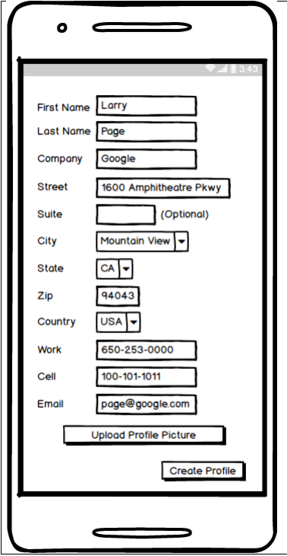
New Profile Page
Place your screenshot here
This page allows new user to create a profile for his/her account. Some basic information such as First Name, Last Name, Company, Business Address, Work Number, Cell, and Email Address could be entered through this page. The user also has an option to upload a profile picture if desired. Other information such as LinkedIn Profile, Company Website, Fax, Position could be added here despite the space limit in our wireframe.

Slide 11
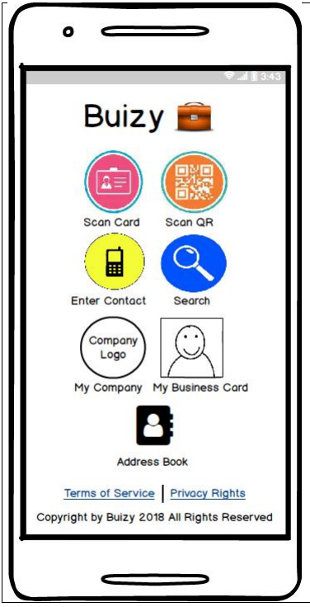
Landing Page
Place your screenshot here
This is the main page where the functionalities of the app are displayed to the user: 1) Scan Card, 2) Scan QR, 3) Enter Contact, 4) Search, 5) My Company, 6) My Business Card, and 7) Address Book. The Terms of Service and Privacy Rights links are available under the navigation icons.

Slide 12
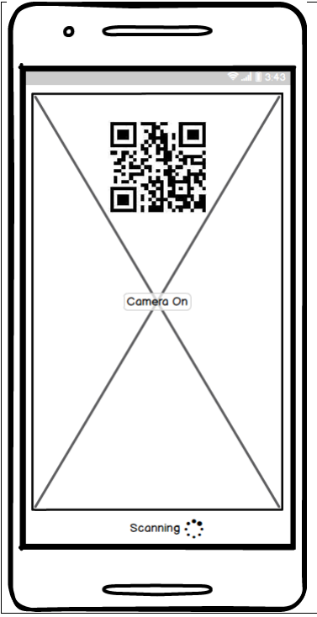
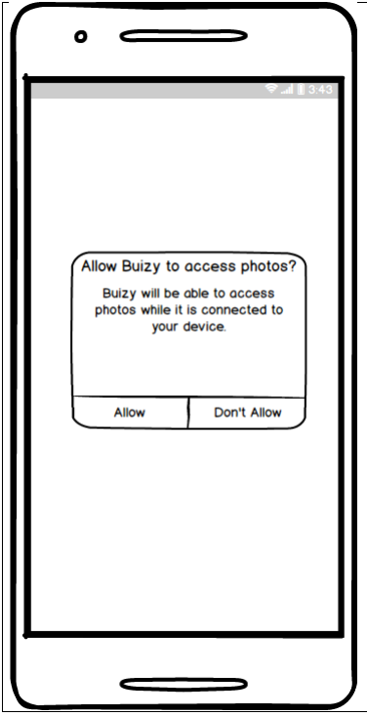
Scanning Information
Place your screenshot here
This is the page where scanning business card is to be taken place to have all the critical information identified and stored within the app.
This page is to allow Buizy to access photos or camera feature on the user’s device. This pop-up window will come up either when the user clicks on Scan Card or Scan QR icons. Disallow camera access will bring the user back to the main page; otherwise, camera feature is allowed to proceed by users click on the allow button.

Slide 13
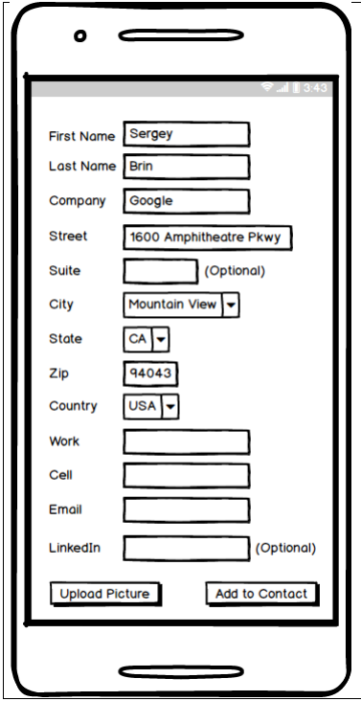
Information Editing
Place your screenshot here
This is the page that allows the user to enter the business contact manually. Despite the basic information displayed here in our wireframe, optional information such as Fax, Facebook, Company Website can also be added by the user. The user can upload a picture for the contact if desired.

Slide 14
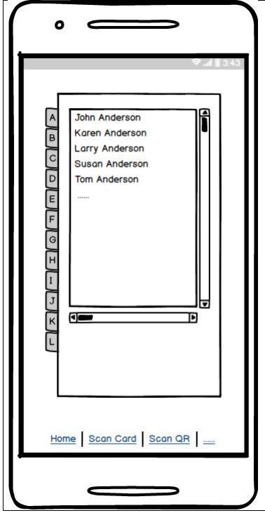
Address Book
Place your screenshot here
This is the page that allows users to browse through their contacts by the last name of each individual.

Slide 15
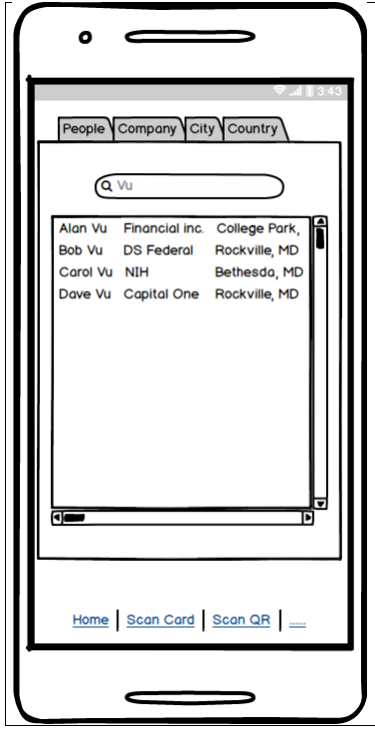
Search and Browse
Place your screenshot here
This is the page that users can search business contacts by people’s name, name of the Company, city, or country. The result would be a list of contacts that matched the search. For example: If the user searches the contact by last name, then the list will be sorted alphabetically by first name. The breadcrumbs at the bottom allows users to perform different functionalities within the app or to go back to the main page if desired.

Slide 16
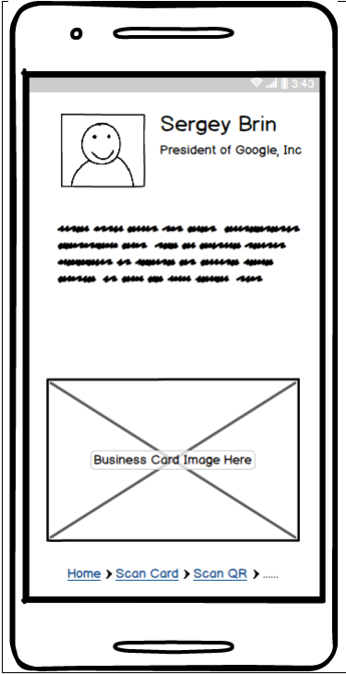
Contacts Pages
Place your screenshot here
This is the information of each individual stored within the app. If a profile picture is uploaded along with the contact, it will be displayed here. Position, Company Name, Work, Cell, Fax, Business Address, Company Website, Linkedln, and other contact information are displayed on this screen. At the bottom of the page, an image of the business card will also be displayed if available.

Slide 17
3. Metadata
We believe you own your own data. We wouldn’t sell our neighbor’s cat, so why is data any different?
Here’s a look at the information we will store.

Slide 18
Metadata is structured infor-
mation that describes, explains,
locates, or otherwise makes it
easier to retrieve, use, or manage
an information resource.

Slide 19
Metadata Schemas
Buizy incorporates descriptive, structural, and administrative types of metadata

Slide 20
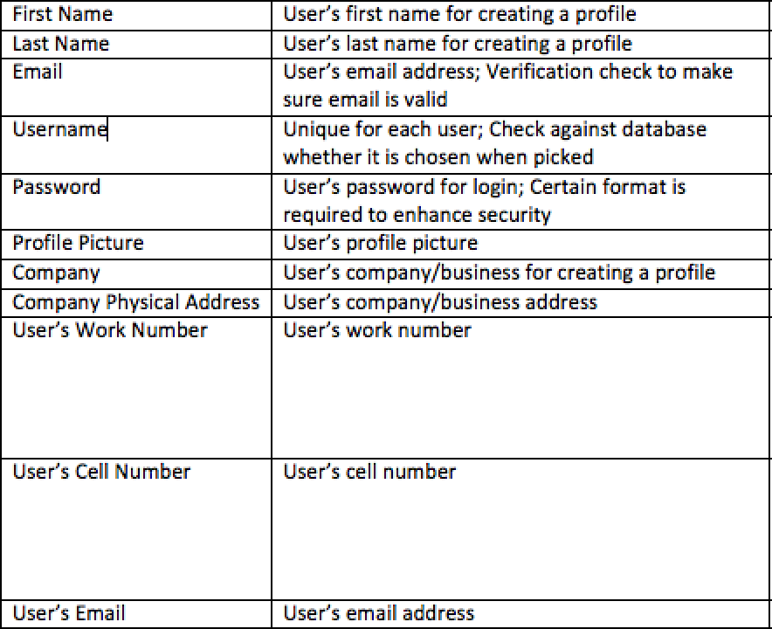
Descriptive: User Profile

Slide 21
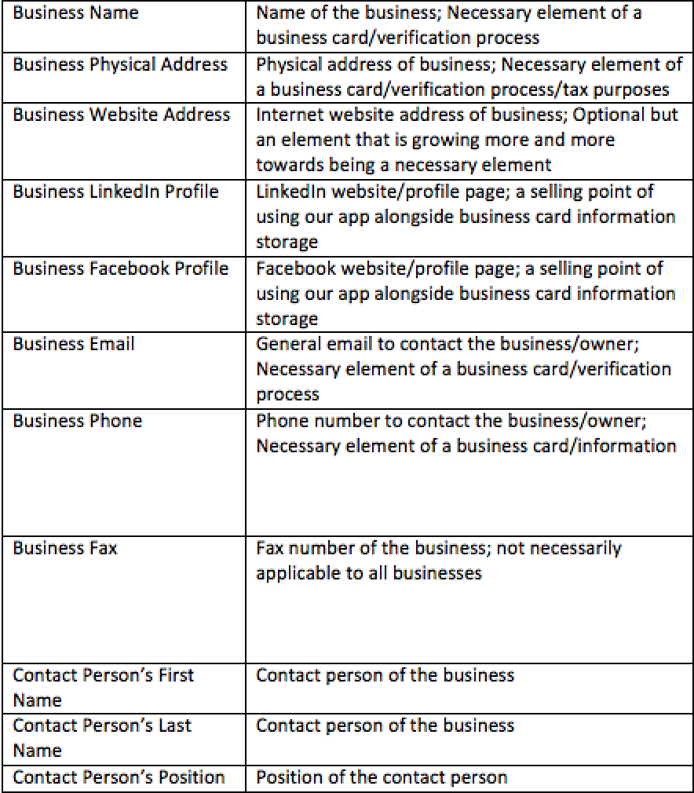
Descriptive: Business Profile

Slide 22
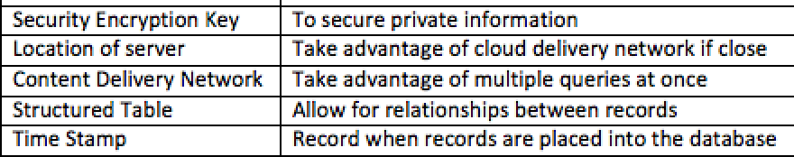
Structural: Database

Slide 23
Administrative: Database

Slide 24
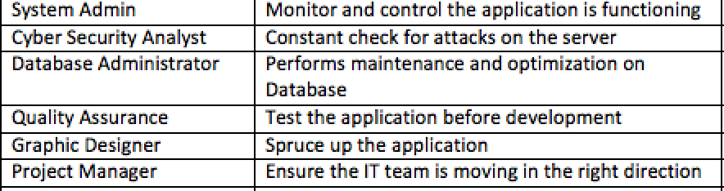
Administrative: Personnel

Slide 25
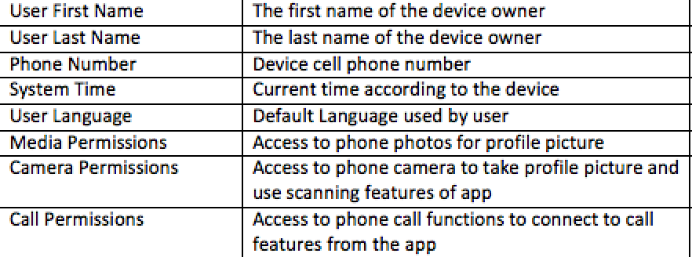
Administrative: Phone/Device

Slide 26
Work’s Cited
US Census Bureau. (2018, August 21). Population. Retrieved December 5, 2018, from https://www.census.gov/topics/population.html
Rainie, L. (2017, June 28). 10 facts about smartphones. Retrieved December 5, 2018, from http://www.pewresearch.org/fact-tank/2017/06/28/10-facts-about-smartphones/

